Slide 1
Network Hacking

Slide 2
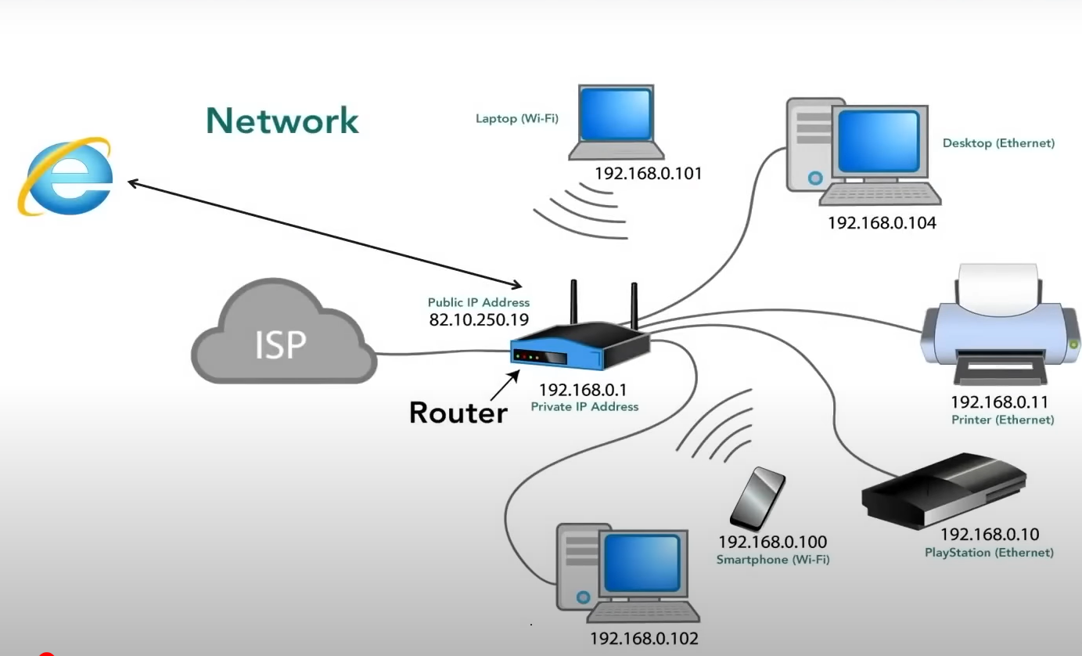

Slide 3

Email Footprinting

Slide 4
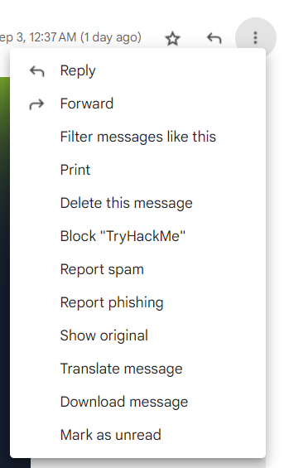

Slide 5
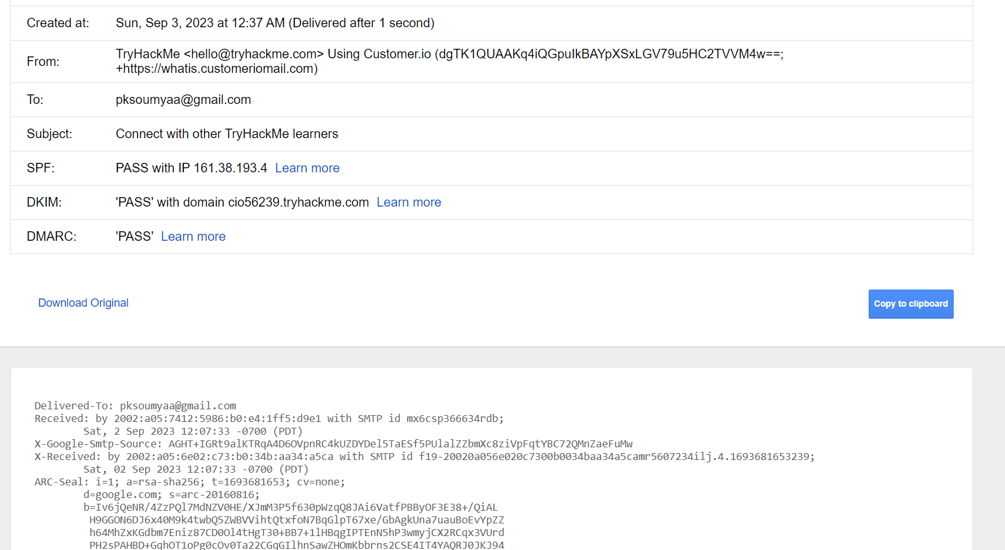

Slide 6
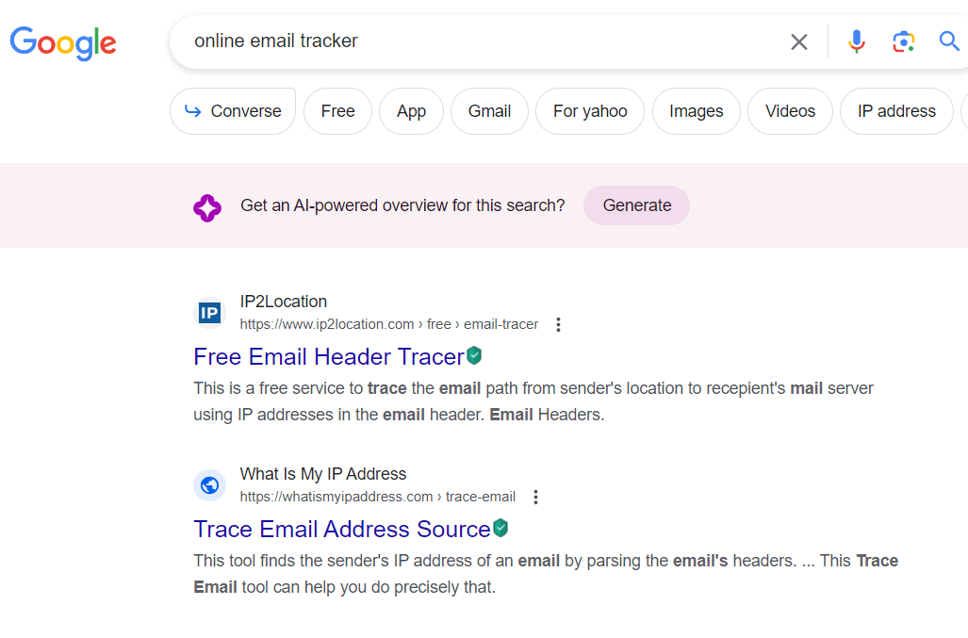

Slide 7
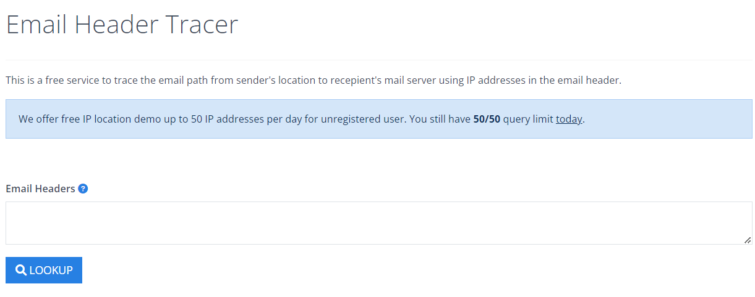

Slide 8
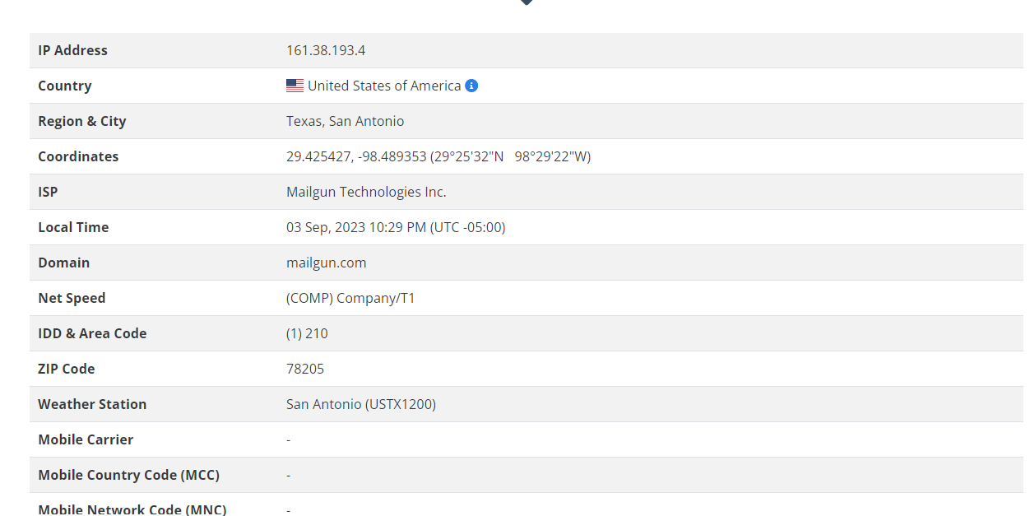

Slide 9




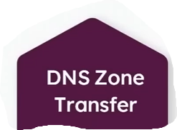
What is Enumeration?

Slide 10
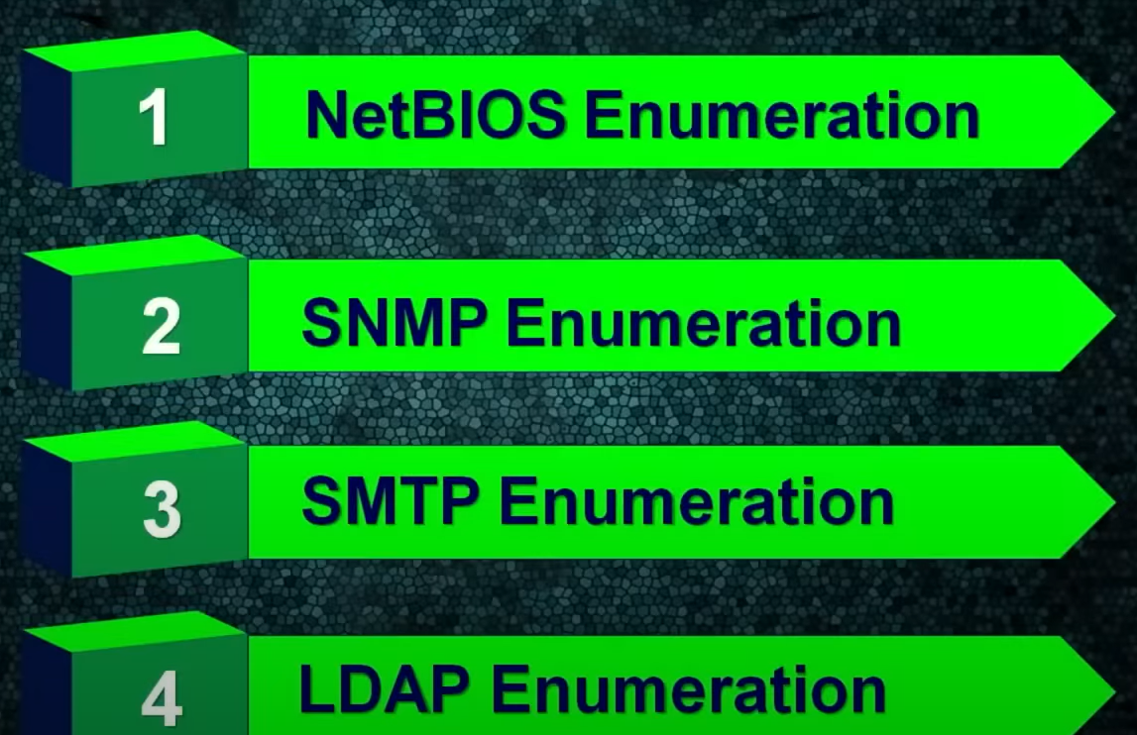
Types of Enumeration

Slide 11
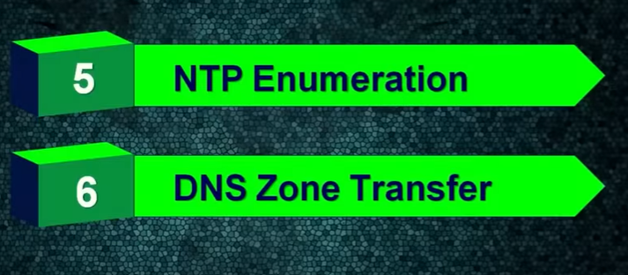

Slide 12
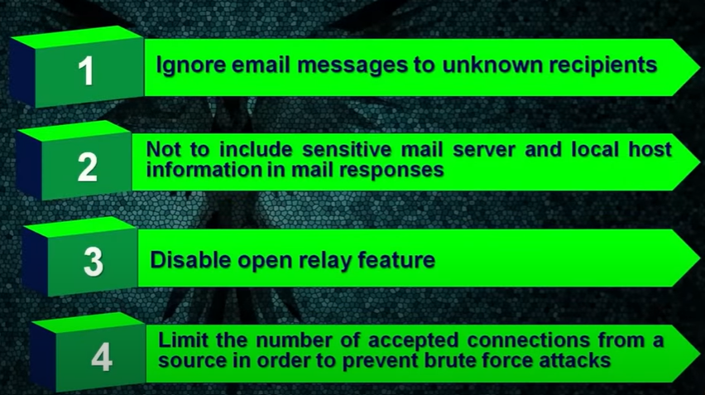
Counter Measure for SMTP

Slide 13
Network Hacking using Yersinia Package
Yersinia is a framework for performing layer 2 attacks.
It is designed to take advantage of some weaknesses in different network protocols.
It pretends to be a solid framework for analysing and testing the deployed networks and systems.

Slide 14
Attacks for the following network protocols are implemented in this particular release:
Spanning Tree Protocol (STP).
Cisco Discovery Protocol (CDP).
Dynamic Trunking Protocol (DTP).
Dynamic Host Configuration Protocol (DHCP).
Hot Standby Router Protocol (HSRP).
802.1q.
802.1x.
Inter-Switch Link Protocol (ISL).
VLAN Trunking Protocol (VTP).

Slide 15
Steps to install yersinia
Open Kali Linux
Type yersinia
If not installed install
And type yersinia -G

Slide 16
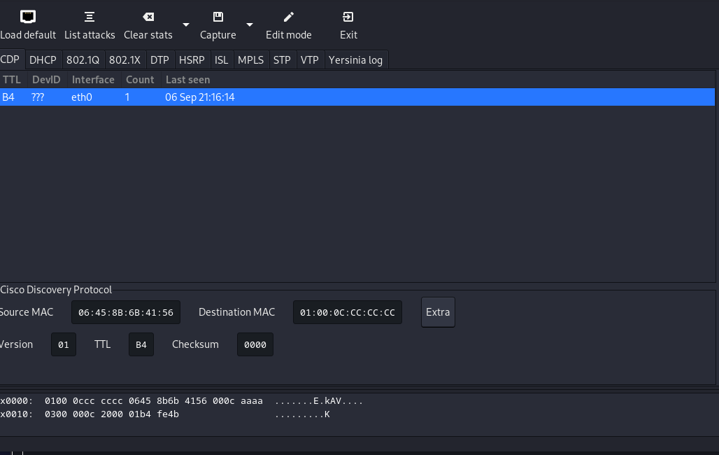
Click launch

Slide 17
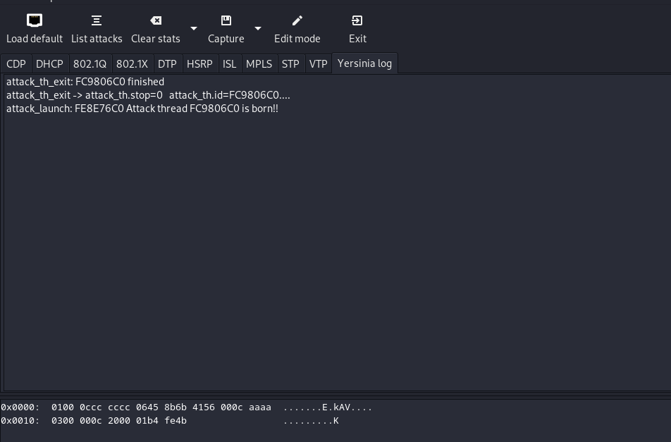
Yersinia Log shows the attack details

Slide 18
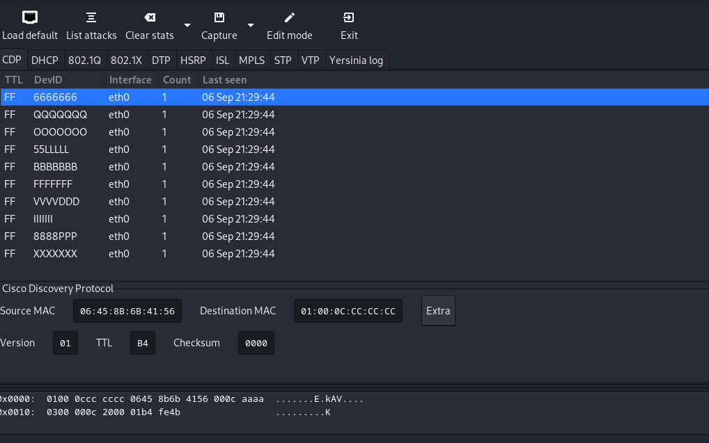
Click launch and click cdp attack

Slide 19
To stop the attack click on
Actions and stop attack

Slide 20
Gaining access to the root using spanning tree
Click on stp
Launch attack
And click on stp tab
Then click on claiming root role

Slide 21
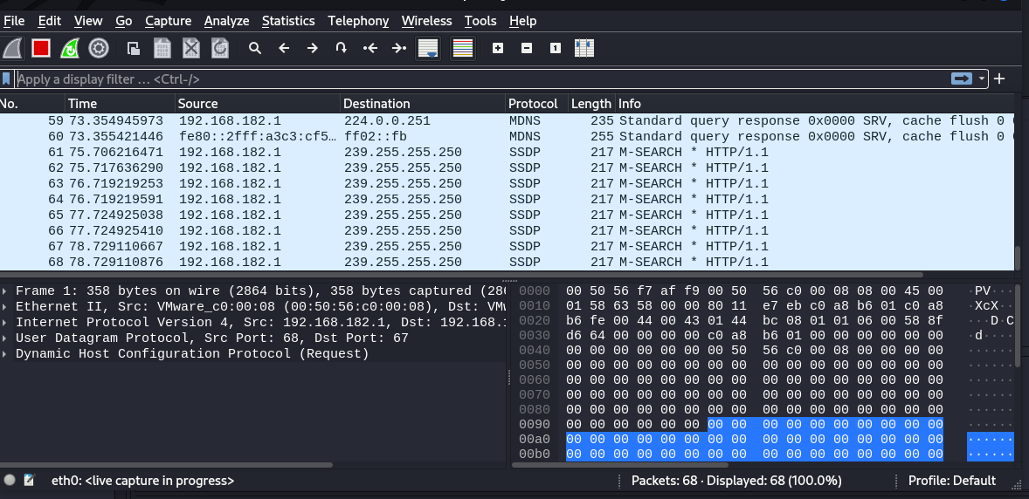
Wireshark
Open Kali Linux and Open Wireshark
Select capture and click start

Slide 22
Type ARP to see the connected devices.

Slide 23
DHTP(Dynamic Host Configuration Protocol)
DHCP is a fundamental building blocks of network today.
Host will broadcast request the DHCP protocol to allocate a IP address and DHCP will allocate IP address to client.
We can hack DHTP
We can exhaust DHTP pool
We route to Kali Linux to act like a default gateway.

Slide 24
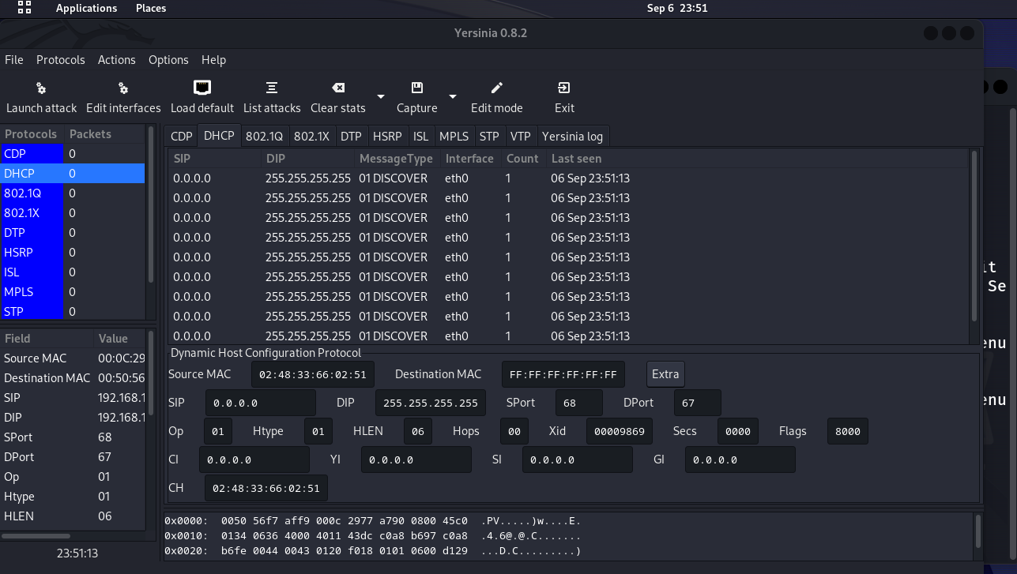

Slide 25
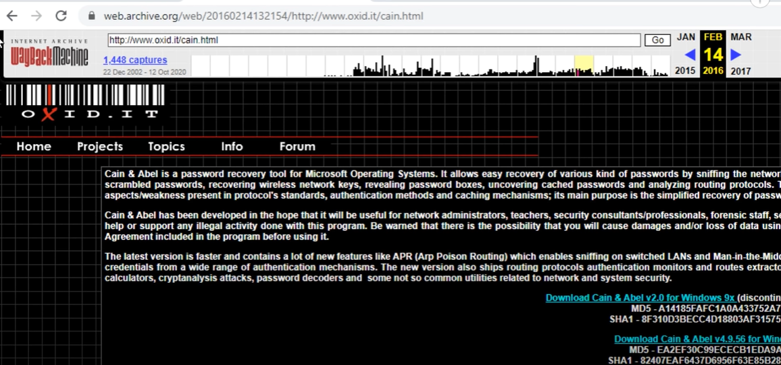
Install Cain and Able Software

Slide 26
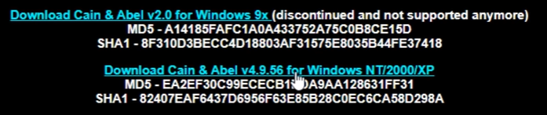
Disable anti virus and download

Slide 27
Another method to gain access to other host is with Hydra
Get access to a host using a particular protocol

Slide 28
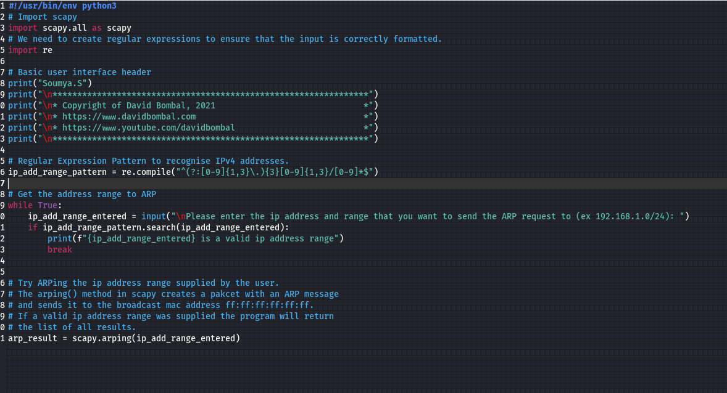
Creating a Python Software Package

Slide 29
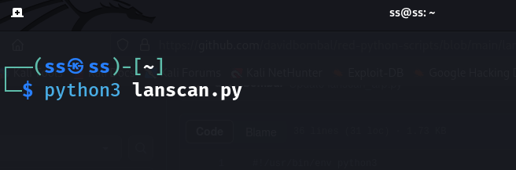

Slide 30
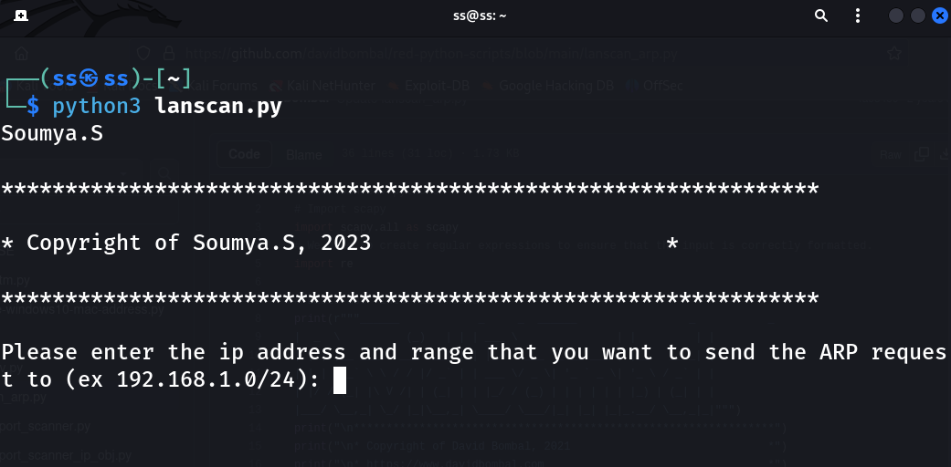

Slide 31
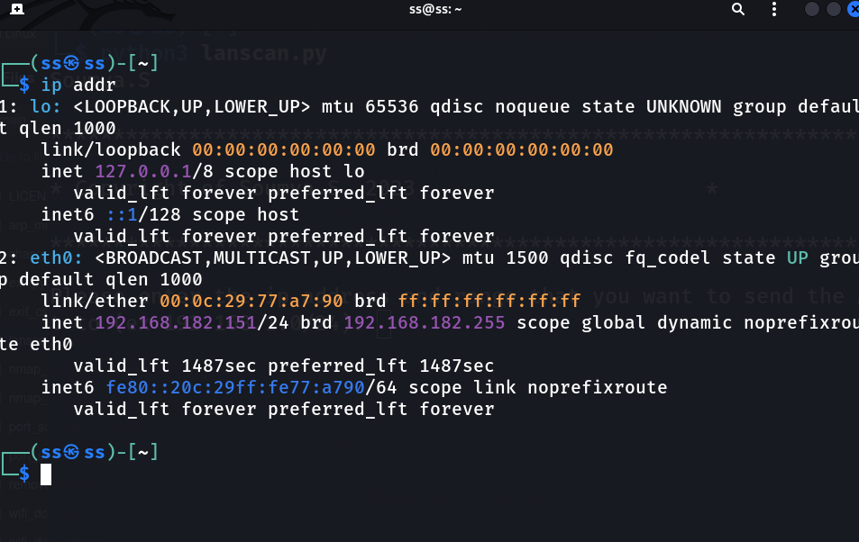

Slide 32
OSPF
Open Shortest Path First (OSPF) is a routing protocol for Internet Protocol (IP) networks.
It's an Interior Gateway Protocol (IGP) that distributes routing information between routers in a single autonomous system (AS).
OSPF is used to find the best path between a source and destination router. It's an open standard, so many network vendors implement it.

Slide 33
Let us know using Wire Shark
Which version of OSPF is used in this topology?
Is authentication used? Which Type?
What is the password used?
Which OSPF area is used?
What are the router OSPF priorities?
Which router is the designated router?

